Slide 1
AFII seminar: Developing applications for the Research Council of Norway
10.00- 10.30 Øyvind Drivenes, Senior Adviser at AFII: Measures for communication and exploitation
10.30- 11.00 Jeppe Aagaard Jeppesen, Adviser at Division of Communications

Slide 2
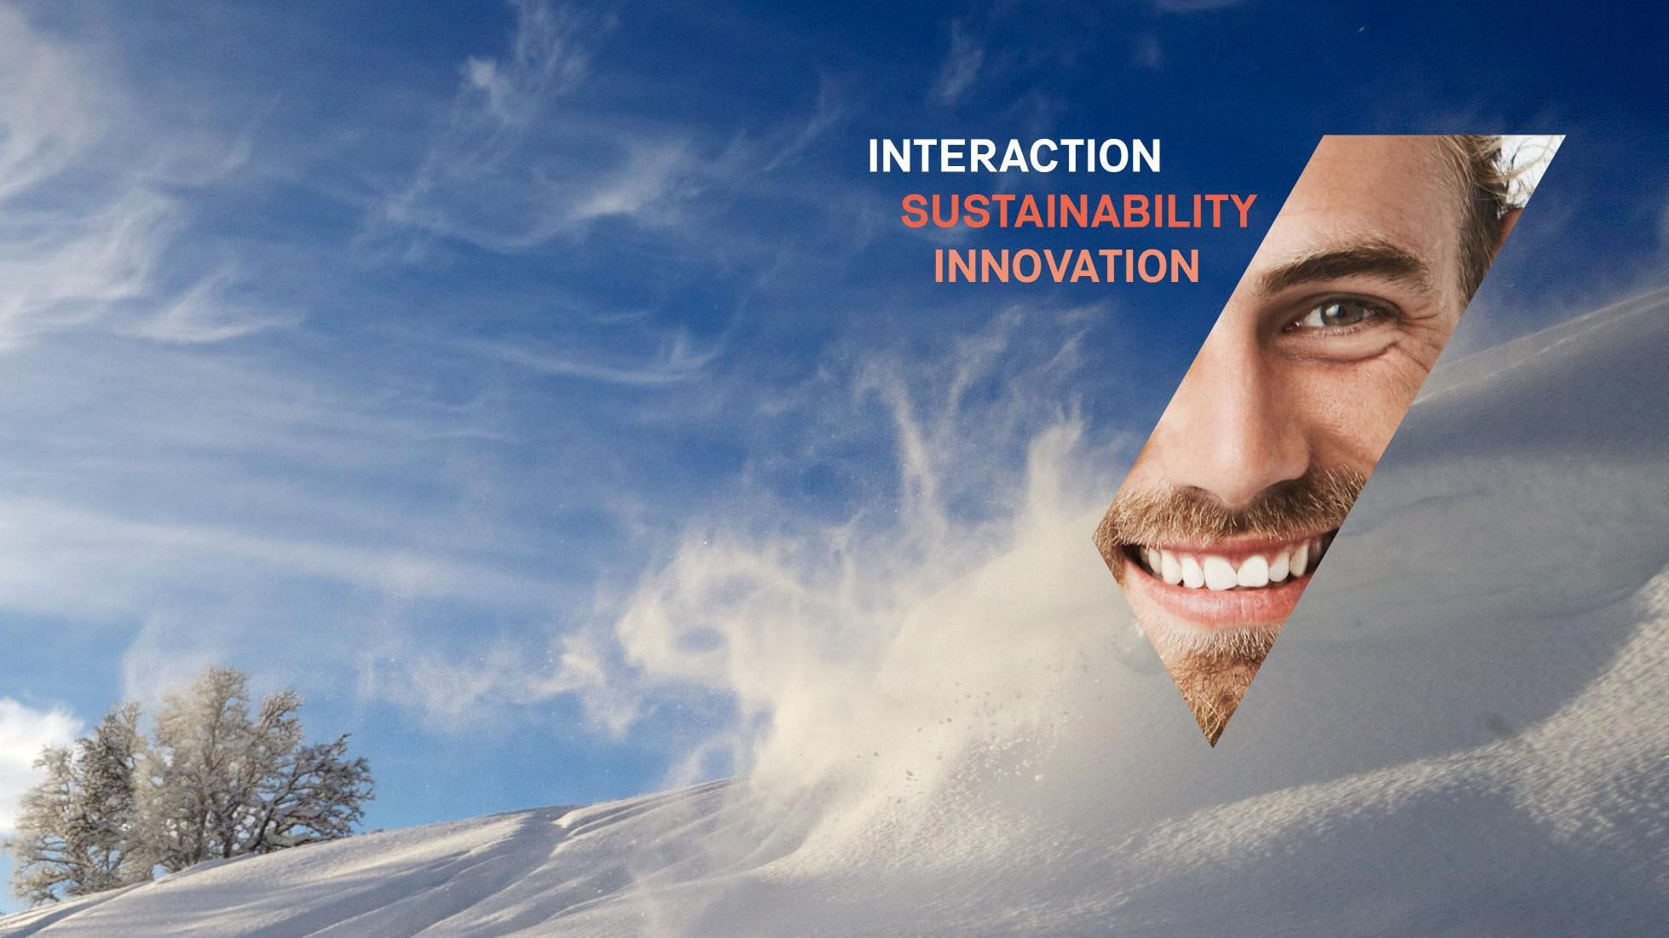

AFII seminar RCN Applications
Measures for communication and exploitation
Øyvind Drivenes
11. jan . 2023

Slide 3
Proposal structure
State of the art and knowledge needs
Research questions and hypotheses
Project objectives
Concept/Theoretical approach and methodology; WPs
Novelty and ambition
Excellence
Expected/Potential impact of the proposed research
scientific, societal, economic
Measures to maximise impact
dissemination, exploitation and communication
Impact
Implementation
Project manager and project group
Project organisation and management
NFR - Project description template 2023 (11 pages)
Always read the template thoroughly and completely! Follow the template and guidelines and provide all the information
requested (if applicable)

Slide 4
RNC Calls for proposals
Researcher Project (3 calls for proposals)
Application deadline: 08 Feb 2023, 13:00
Collaborative and Knowledge-building
Project (2 calls for proposals)
Application deadline: 15 Feb 2023, 13:00
2.3 Measures for communication and exploitation
Describe open science practices to ensure early and open sharing and wide distribution of research outputs.
Describe briefly the target audiences, including stakeholders/users, of the project outputs (in or beyond the scientific community).
Outline the scope and plan for dissemination, communication and engagement activities.
Provide a brief description of planned activities that will contribute to the realisation of the potential impacts of the project outputs (in or beyond the scientific sphere).
2.2 Measures for communication and exploitation
Describe the target audiences and stakeholders/users of the project outputs (in or beyond the scientific community).
Outline the scope and plan for dissemination, communication and engagement activities.
Provide a brief description of planned activities that will contribute to the realisation of the potential impacts of the project outputs (in or beyond the scientific sphere).
Describe open science practices to ensure early and open sharing and wide distribution of research outputs.
Describe how the stakeholders/users are involved in the dissemination and utilisation of the project results.
Notes:
Scientific Renewal, Young talent, Large scale interdisciplinary
Societal and Industry-related Challenges,
Knowledge-building projects for industry

Slide 5
Some defenitions:
What is….?
Communication:
Strategic and targeted measures to make the project and results visible to a broad-spectrum audience, including the media and the public, preferably in dialogue.
Dissemination:
publication and awareness raising of project results. Make the research results known to various stakeholders (such as academia, industry, organizations, and decision-makers) in a targeted way so that they can use the results in their work.
Exploitation:
use of results during or after the project for commercial purposes, but also to improve policies to solve economic and social problems.
Dissemination and Exploitation:
Is a process for promoting, raising awareness and gaining commitment from stakeholders for successful utilization of project results.
Commercialization:
process for launching project results (product, service, knowledge) in a market.

Slide 6
Using communication, dissemination and exploitation to achieve the highest possible Impact.
communication
Dissemination
Exploitation /
Use / utilization
Activity
«Stakeholders» who potentially can use the results
Real users of the results. Knowledge transfer
Several target groups
Target audience
Inform the community about the usefulness of the project
Use of results for scientific, social or economic purposes-
MAXIMIZE IMPACT
Facilitate usage of the results
Objective

Slide 7

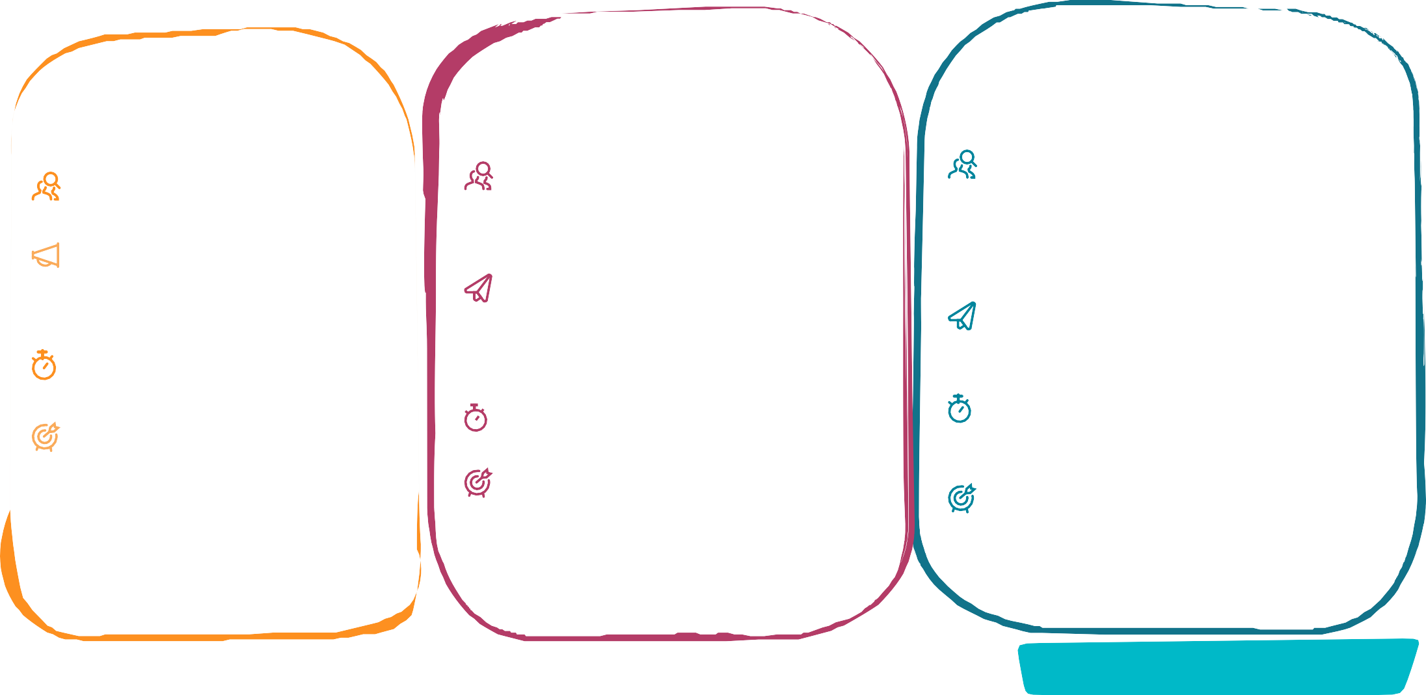

COMMUNICATION, DISSEMINATION AND EXPLOITATION
WHY THEY ALL MATTER AND WHAT IS THE DIFFERENCE?
Communication:
Promote your action and results
Inform, promote and communicate your activities and results
Reaching multiple audiences
Citizens, the media, stakeholders
Dissemination:
Make your results public
Open Science: knowledge and results (free of charge) for others to use
Only to scientists?
Not only but also to others that can learn from the results: authorities, industry, policymakers, sectors of interest, civil society
Exploitation:
Make concrete use of results
Commercial, Societal, Political Purposes
Only by researchers?
Not only, but also:
Industry including SMEs
Those that can make good use of them:
authorities, industrial authorities, policymakers, sectors of interest, civil society
How?
Creating roadmaps, prototypes, softwares
Sharing knowledge, skills, data
When?
Towards the end and beyond, as soon as the action has exploi- table results
Why?
Lead to new legislation or recommendations
For the benefit of innovation, the economy and the society
Help to tackle a problem and respond to an existing demand
Legal obligation of your Grant Agreement
How?
Having a well-designed strategy
Conveying clear messages
Using the right media channels
How?
Publishing your results on:
Scientific magazines
Scientific and/or targeted conferences
Databases
When?
From the start of the action until the end
Why?
Engage with stakeholders
Attract the best experts to your team
Generate market demand
Raise awareness of how public money is spent
Show the success of European collaboration
When?
At any time, and as soon as the action has results
Why?
Maximise results’ impact
Allow other researchers to go a step forward
Contribute to the advancement of the state of the art
Make scientific results a common good
Legal obligation of your Grant Agreement
Legal obligation of your Grant Agreement
What else?
Acknowledge the EU funding!

Slide 8

Impact chain from a research council’s
perspective
Input
Activities
Outputs
Outcomes
Impact
Research programmes
Research
Publications
New research questions
Solving
challenges
Organising
Patents
Funding
New knowledge, Competency
Employment
Infra- structures
Workshops
Products
Dialogue
Transition
Processes
New structures
Economy
Policy
Stig Slipersæter

Slide 9
Use communication, dissemination and exploitation to achieve the highest possible Impact
Input
Activities
Outputs
Outcomes
Impact
Research programmes
Research
Publications
New research questions
Solving
challenges
Organising
Patents
Funding
New knowledge, Competency
Employment
Infra- structures
Workshops
Products
Dialogue
Transition
Processes
New structures
Economy
Policy
Stig Slipersæter

Slide 10
2.2/2.3 Measures for communication and exploitation
  Describe the target audiences and stakeholders/users of the project outputs (in or beyond the scientific community).
  Outline the scope and plan for dissemination, communication and engagement activities.
  Provide a brief description of planned activities that will contribute to the realisation of the potential impacts of the project results/outputs (in or beyond the scientific sphere).
  Describe how the stakeholders/users are involved in the dissemination and utilization of the project results*
  Describe open science practices to ensure early and open sharing and wide distribution of research outputs.
*Only for Collaborative and Knowledge-building Project

Slide 11
Describe the target audiences and stakeholders/users of the project outputs (in or beyond the scientific community).
Identify the target group/ audience:
Researchers,
Universities and research organisations,
General Public,
Industry,
SMEs,
media,
policy and makers decision-makers

Slide 12
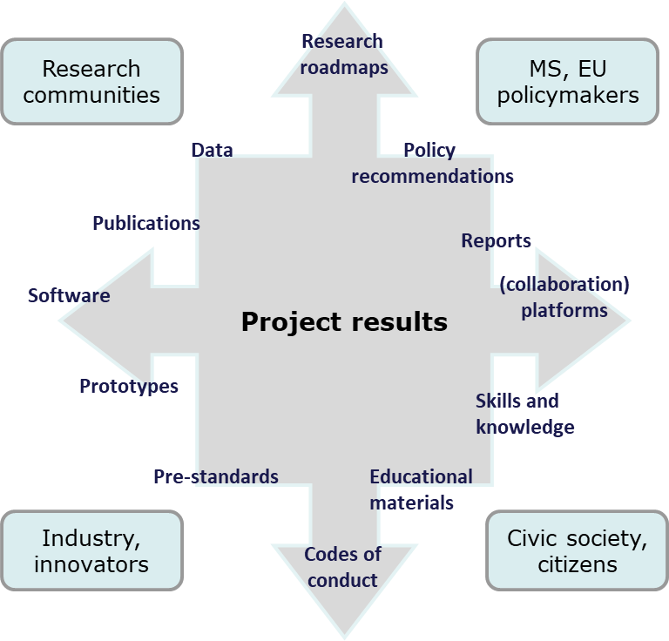

Identification of stakeholders and results/outputs
What is project results/outputs?
Any tangible or intangible output of the action, such as data, knowledge and information whatever their form or nature, whether or not they can be protected.
Key exploitable results are the outputs generated during the project which can be used and create impact, either by the project partners or by other stakeholders.
Project results can be reusable and exploitable (e.g. inventions, prototypes, services) as such, or elements (knowledge, technology, processes, networks) that have potential to contribute for further work on research or innovation.

Slide 13
Outline the scope and plan for dissemination, communication and engagement activities.
WHAT: Activities, key events and Research results
WHY: visibility and prestige, impact, responsibility to citizens (accountability), public opinion,
TO WHOM: General Public, Researchers, Industry, SMEs, Universities, research organisations, Multipliers (media in particular), Decision-makers
WHERE: media (TV, press…), scientific journals, workshops, meetings
HOW: website, flyers, press releases, scientific publications, pictures, artworks, videos
WHEN: on time, project life cycle.

Slide 14
Scope and plan for dissemination, communication and engagement activities
What
to be
To
Why
How
Commu nication
When
By
Whom
How
communicated
Whom
(Communication
much?
Communication
Methods)
Level
(Resources
Milestones
(L/R/N/ E/G)
Needed)

Slide 15
Scope and plan for dissemination, communication and engagement activities
What
to be
To
Why
How
Commu nication
When
By
Whom
How
communicated
Whom
(Communication
much?
Communication
Methods)
Level
(Resources
Milestones
Monitoring! Is it effective?
(L/R/N/ E/G)
Needed)
If not, re-consider & adjust!

Slide 16
Provide a brief description of planned activities that will contribute to the realisation of the potential impacts of the project outputs (in or beyond the scientific sphere).
To answer this, one must identify the potential outcome and impacts of the project.

Slide 17
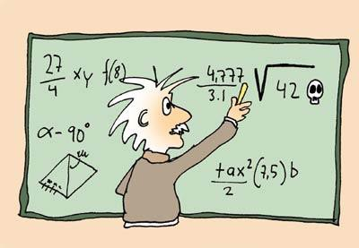
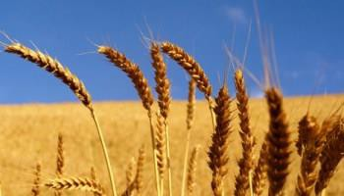
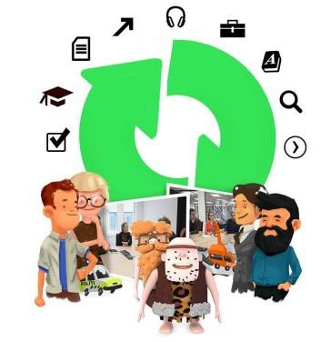
What are the potential outcomes and impacts?
7
Scientific/academic impacts
  World class science, highly cited, core contribution to scientific fields
  Capacity building
  International and transdisciplinary collaborations
Societal impacts
  Research results addressing and tackling societal challenges, national thematic or UN SDGs
  Societal R&I uptake
Economic and innovation impacts
  Innovations and economic growth
  Employment
Emphasis will vary between application types

Slide 18

Provide a brief description of planned activities that will contribute to the realisation of the potential impacts of the project outputs (in or beyond the scientific sphere).
Dissemination
  Articles, books, conference presentations, Open Science
Communication
  How will the world know about the project?
Capacity and competence building, skills
  PhD, post grad courses
  Stakeholder training
Exploitation
  Knowledge transfer with public sector/industry
  Products, patents & new processes
Collaborations
  Academic - international, cross/transdisciplinary
  Non-academic stakeholders

Slide 19

Describe how the stakeholders/users are involved in the dissemination and utilization of the project results
Collaborative and Knowledge-building Project is required to incorporate user involvement.
A thorough stakeholder analysis at the beginning of the project allows to identify and target specific stakeholders who can be interested in the expected results, outcome and impact of the project.

Slide 20

Stakeholder/user involvement
Collaborative and Knowledge-building Project is required to incorporate user involvement.
In the application you must:
Describe who your users are.
Describe how users are involved in planning, implementation and exploitation of results.
Explain the importance of user involvement and how the user perspective is secured.
By Lightspring/ Shutterstock

Slide 21
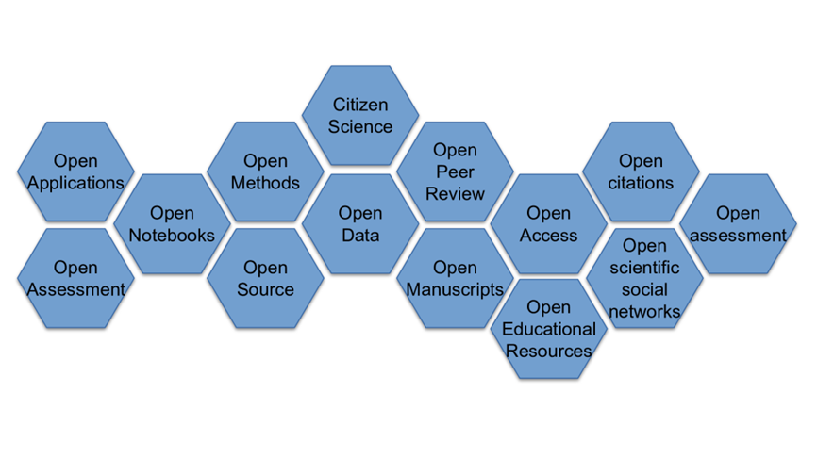
Describe open science practices to ensure early and open sharing and wide distribution of research outputs.
Open science means transparency and knowledge-sharing in research processes to make knowledge accessible across academic groups, sectors and national boundaries. The concept of open science encompasses the entire research process […].
Source: The Research Council of Norway. Policy for open science 2020
Source: www.arj.no/2020/08/27/open-research/

Slide 22
Why open research?
The Research Council of Norway’s new policy for Open Research mentions three main goals
Contributing to a well functioning research system
Contribute to sustainable development
Strengthening trust in research
Source: The Research Council of Norway, policy for Open Research
Opening the research process:
  Transparency
  Knowledge sharing
  Supports validation and reproducibility
  Reduces cases of academic misconduct
  May reduce the cost of scholarly publishing
  Citation advantage
It helps to maximize:
The quality and impact of research
Provides the foundations for others to build upon

Slide 23
Open science practices include
Early and open sharing of research (for example through preregistration, registered reports, pre-prints, or crowdsourcing).
Research output management including research data management
Measures to ensure reproducibility of research outputs.
Providing open access to research outputs (e.g. publications, data, software, models, algorithms, and workflows) through deposition in trusted repositories.
Participation in open peer review.
Involving all relevant knowledge actors including citizens, civil society and end users in the co-creation of R&I agendas and contents (such as citizen science)
Please look at The Research councils “Assessment of open science in grant applications” by following the link below:
https://www.forskningsradet.no/en/processing-grant-applications/processing-applications/assessment-open-science/
Notes:
The preregistration is the documentation of planned hypotheses, research design, and analyses before beginning the research and making this available
where review reports and reviewers' identities are published alongside the articles,
Crowdsourcing is a beneficial research method that allows members of the public to contribute ideas and time to projects despite not being formally trained experts

Slide 24
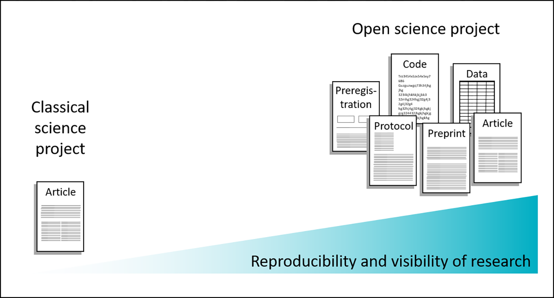
Published outcomes of classic versus open science projects

Slide 25
The Research Council's evaluation criteria of dissemination and communication of results
This criterion gives an indication of the quality of the dissemination and communication plans for the project. Dissemination and communication of results will be assessed in relation to the following points:
Plans for scholarly publication, dissemination and other communication activities.
Plans for popular science dissemination and communication activities vis-à-vis the general public as well as users of the project results, including planned use of channels and measures.
Plans for ensuring that important users (in industry, community life and public administration) are incorporated into/take part in dissemination activities for the project.
When assessing dissemination and communication plans, importance should be attached to the level of detail provided and how realistic the plans are.
Describe to what extent and how you will adopt early and open sharing. For example, you can mention what type of early and open sharing is appropriate for your discipline and project, such as preprints or pre-registration and/or registration reports, and which publishing platforms you plan to use.

Slide 26
Some final tips
Be as specific as possible (and explain why/impact)
Name journals, conferences, …
Name stakeholders and how they will benefit
Separate work package for Dissemination & Exploitation?
Dissemination/communication activities should be planned throughout the project
Concrete planning for exploitation, dissemination and communication activities must be included in the Gantt chart.
Involve potential stakeholders in your proposal if possible (e.g., steering committee, agreed-upon training, secondment, …) → multipliers
Include in your planning/propsal that you will review your dissemination and exploitation plan

Slide 27
